Slide 1


AERAVAT ARTIFICIAL INTELLIGENCE HACKATHON 1.0
DOMAIN : MACHINE LEARNING
BUGS BASHERS :
KARTIK BATCHU
ANKUSH VERMA
RUSHIKESH JOSHI
YASH LODHI
CUSTOMER CHURN PREDICTION FOR TELECOMMUNICATIONS COMPANY

Slide 2
WHAT IS CHURN Rate in telecommunication?
Churn rate in telecommunications measures the percentage of subscribers who terminate their service within a given timeframe. Key points include:
Customer Retention: High churn rates signify customer dissatisfaction, leading to revenue loss and reduced market share.
Factors Influencing Churn: Reasons for churn vary from poor service quality to better deals from competitors, necessitating strategies to address these issues.
Churn Management Strategies: Telecom companies employ tactics such as improving customer service, offering competitive pricing, and leveraging data analytics to retain customers and sustain growth.

Slide 3
Factors affecting churn rate in telecommunications include:
Service Quality: Poor network coverage, frequent service disruptions, slow data speeds, and dropped calls can lead to dissatisfaction among subscribers, prompting them to switch to competitors with better service quality.
Price and Value Perception: High subscription fees, hidden charges, and limited features compared to the price paid can drive customers to seek more affordable or better value-for-money options offered by competitors.
Customer Service Experience: Unresponsive customer support, long wait times, and ineffective issue resolution can result in frustration and dissatisfaction, prompting customers to switch providers for better customer service experiences.

Slide 4
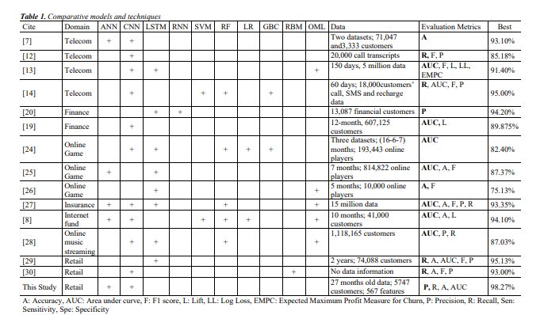
COMPARISON OF DIIFERENT ALGORITHMS THAT ARE USED FOR TELECOM AND RETAIL

Slide 5
Algorithms involved in processing: 1) Logistic regression
Classification Algorithm: Logistic regression is a statistical method used for binary classification tasks, where the outcome variable is categorical with two possible outcomes.
Probability Estimation: It estimates the probability that a given input belongs to a particular class using a logistic function, which maps input features to a value between 0 and 1.
Decision Boundary: Logistic regression uses a decision boundary to separate data points into different classes based on their predicted probabilities.

Slide 6
2) RANDOM FOREST
Ensemble Learning Method: Random Forest is an ensemble learning method that builds multiple decision trees during training and outputs the mode of the classes (classification) or the mean prediction (regression) of the individual trees.
Feature Randomness: Each tree in a Random Forest is trained on a random subset of the features from the dataset. This randomness helps to decorrelate the trees, reducing the risk of overfitting and improving the model's generalization performance.
Bootstrap Aggregating (Bagging): Random Forest employs a technique called bootstrap aggregating or bagging, where each tree is trained on a bootstrapped sample of the training data (sampling with replacement). This further diversifies the trees and enhances the model's robustness.

Slide 7
3) XG BOOST CLASSIFIER
Gradient Boosting Algorithm: XGBoost (Extreme Gradient Boosting) is an implementation of the gradient boosting machine learning algorithm, specifically designed for speed and performance.
Tree Ensemble Method: XGBoost builds an ensemble of decision trees sequentially, where each tree corrects the errors made by the previous ones, resulting in a strong predictive model.
Regularization Techniques: XGBoost integrates regularization techniques like L1 (Lasso) and L2 (Ridge) regularization to prevent overfitting by penalizing complex models.
Optimized Performance: XGBoost is highly optimized for efficiency and scalability, utilizing techniques such as parallelization, tree pruning, and cache-aware access to data structures.

Slide 8
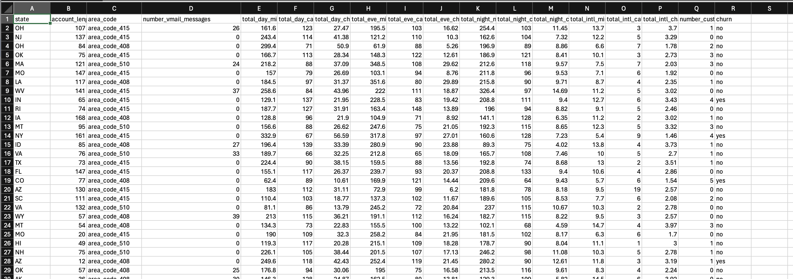
Dataset used for the implementation

Slide 9
CONCLUSION
By utilizing the XGBoost classifier, we have effectively analyzed the prediction rate of customer churn. XGBoost's robust gradient boosting algorithm, coupled with its regularization techniques and optimized performance, allowed us to build a predictive model capable of accurately identifying potential churners. Through the ensemble of decision trees and feature importance insights provided by XGBoost, we gained valuable insights into the factors influencing churn, enabling proactive measures to retain customers.

Slide 10
THANK YOU

